Slide 1



PREDICTIVE VEHICLE MAINTENANCE WITH ROAD ANALYSIS
KONGU ENGINEERING COLLEGE
PERUNDURAI ERODE-638060
Department of Computer Science and Engineering
22CSP72 – PROJECT WORK II PHASE II
PRESENTED BY :
MEDHUNA P 23CSR127
PRAVEENA S 23CSR166
RAGAVI K 23CSR169
MENTOR :
MR T ARUNKUMAR

Slide 2
PROBLEM STATEMENT
Unexpected vehicle failures cause delivery delays, increase repair costs, and reduce the overall efficiency of logistics operations.
Traditional maintenance follows fixed schedules and cannot accurately predict vehicle failures before they occur.
Emergency repairs increase maintenance expenses and may lead to unnecessary replacement of vehicle components.
Long vehicle downtime reduces fleet availability, affecting transportation services and customer satisfaction.
Machine Learning can analyze historical vehicle data to predict maintenance needs in advance, reducing costs and improving fleet reliability.

Slide 3
OBJECTIVES
Analyze vehicle and road condition data
Classify road surface conditions
Predict maintenance requirements
Detect potential vehicle failures early
Compare different Machine Learning algorithms.
Develop an intelligent maintenance prediction system.
.

Slide 4
LITERATURE SURVEY
S.no | Title of Paper | Author / Year | Proposed Work | Limitation
1 | A Comprehensive Study on Predicting the Need for Vehicle Maintenance Using Machine Learning | Muhammad Umair et al., 2025 | Developed a predictive maintenance framework using Decision Tree, Random Forest, Gradient Boosting, KNN, and Naïve Bayes. Applied SMOTE to balance the dataset and compared model performance using accuracy, precision, recall, and F1-score. | kaggle dataset only; overfitting risk on imbalanced data. No time-series or DL models.
2 | Using Support Vector Machines to Classify Road Surface Conditions to Promote Safe Driving | Jaepil Moon & Wonil Park, 2024 | Proposed an SVM-based classification model using weather and road surface data to identify road conditions accurately and improve driving safety. | Only SVM used; no other ML compared. Road pavement thermal properties not considered.
3 | An integrated deep learning approach for predictive vehicle maintenance | Abderrachid Errezgouny et al., 2025 | Proposed a hybrid LSTM + K-Means model using OBD sensor data for predictive maintenance, achieving high prediction accuracy for vehicle health monitoring. | Single vehicle only; fixed K limits adaptability. No RUL estimation or fault diagnosis.

Slide 5
RESEARCH GAP
Existing systems focus only on vehicle data
Road conditions are analyzed separately
Road impact on vehicle wear is often ignored
No integrated AI-based prediction framework
Limited real-time monitoring and maintenance support

Slide 6
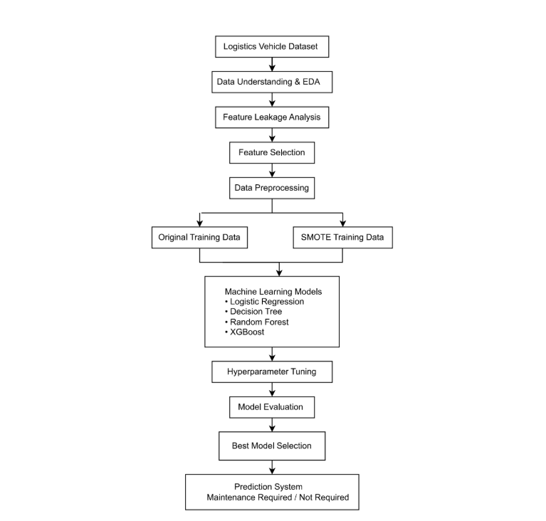
ARCHITECTURE DIAGRAM

Slide 7
PROPOSED WORK WITH PLANNED INNOVATION
Proposed Work
Develop a machine learning-based predictive maintenance system for vehicles.
Collect and preprocess vehicle maintenance data to improve data quality.
Eliminate feature leakage and select the most relevant features.
Train and compare multiple machine learning models.
Identify the best-performing model for accurate maintenance prediction.
Perform feature leakage analysis to ensure reliable and unbiased predictions.
Compare multiple machine learning algorithms instead of using a single model.
Apply hyperparameter tuning to optimize model performance.
Evaluate models using multiple metrics such as Accuracy, Precision, Recall, F1-Score, and ROC-AUC.
Design a scalable framework that can be extended to integrate real-time vehicle sensor and road-condition data.
Planned Innovation

Slide 8
MODULES OF THE PROJECT
MODULE | DESCRIPTION
Vehicle Maintenance Dataset Preparation | Import and organize IoT-enabled vehicle maintenance and road condition data.
Data Cleaning & Feature Engineering | Perform preprocessing, feature encoding, scaling, and leakage removal.
Road Condition Analysis | Analyze the influence of road and weather conditions on vehicle health and maintenance requirements.
Predictive Model Training | Develop Logistic Regression, Decision Tree, Random Forest, and XGBoost models.
Performance Optimization | Improve model performance using SMOTE, Hyperparameter Tuning, and Feature Selection.
Final Maintenance Prediction Model | Deploy the optimized model to predict vehicle maintenance requirements with road condition analysis.

Slide 9
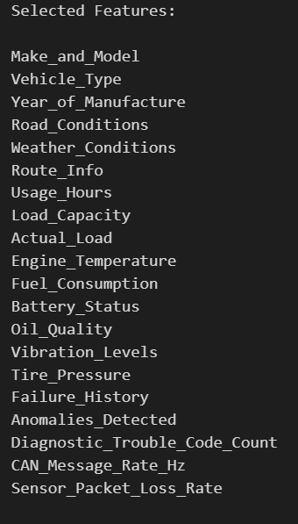
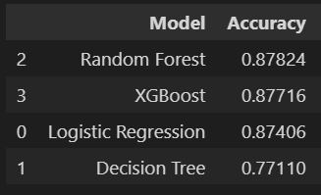
OUTPUT

Slide 10
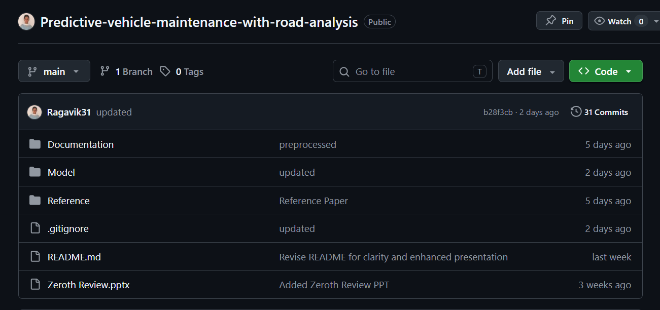
GIT DOCUMENTATION

Slide 11
THANK YOU

